Slide 1
Positive Cells
Group
Negative Cells
Group
Load
Cell1
Diodes for Return Paths
Cell1
Cell2
Cell2
Rs
Laser
Cell
=
Iph
D
Rp
Dbypass
Cell-n
Cell-n

Slide 2
Positive Cells
Group
Negative Cells
Group
Load
Rs
Laser
Cell1
Diodes for Return Paths
Cell1
Cell
=
Iph
D
Rp
Cell2
Cell2
Dbypass
Cell-n
Cell-n

Slide 3
Positive Cells
Group
Negative Cells
Group
Load
Cell1
Diodes for Return Paths
Cell1
Cell2
Cell2
Cell-n
Cell-n

Slide 4
Positive Cells
Group
Negative Cells
Group
Load
Cell1
Diodes for Return Paths
Cell1
Cell2
Cell2
Cell-n
Cell-n

Slide 5
Positive Cells
Group
Negative Cells
Group
Positive Cells
Group
Negative Cells
Group
Load
Load
Cell1
Diodes for Return Paths
Cell1
Cell1
Diodes for Return Paths
Cell1
Cell2
Cell2
Cell2
Cell2
Cell-n
Cell-n
Cell-n
Cell-n
(a)
(b)

Slide 6
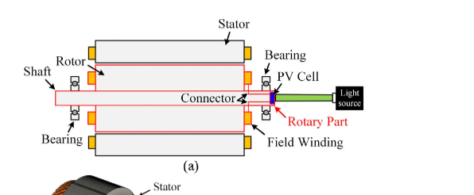
Light Sources
Stator
PV Cells
Bearing
Rotor
LS1
Shaft
LS2
LS3

Slide 7
Rs
Laser
Iph
D
Rp
Load
Dbypass

Slide 8
Stator
PV Cells
Light Source
Bearing
Rotor
Shaft
LS1
Light Sources
Stator
PV Cells
Bearing
Rotor
LS1
Shaft
LS2
LS3

